Slide 1
What is storytelling research? An Example
Outline 2- 4PM
Part I – Directions of my Storytelling Research Methods books 2001-2016
Part II – What Quantitative Narrative Analysis cannot do
Part V – Example of Qualitative Interpretative Method - in situ
David M. Boje
Slides & books to download at http://davidboje.com/Strathclyde/

Slide 2
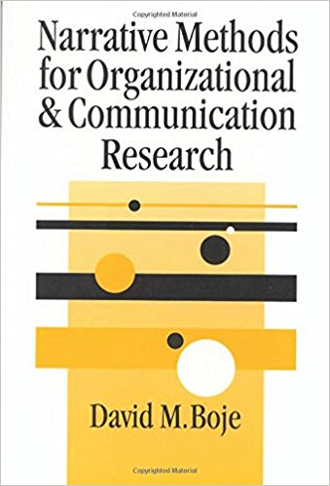
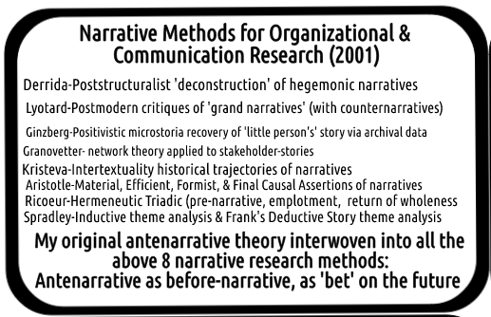

Slide 3
Deconstruction (Boje, 2008b)
Notes:
Figure 2, which you are welcome to reference and use, illustrates the inter-play of the 8 analytic processes (Derrida calls it style). The idea of the narrative deconstruction analysis is to use the first seven steps to flesh out all the missing stuff (missing duality poles, missing view to what is hierarchical hegemony, missing voices, missing sides to the story, missing counter-plots, and missing exceptions to their universalistic principles. The seventh analysis is critical since it now lets you step back and see the full dynamics in play, that ‘control narrative’ (Boje, 2007a; 2001) is leaving out. Step 8, I would argue is the summation of all the prior steps. It allows you to see not just a ‘New perspective” the way you interpret it, but to flesh out the dynamic relations in the fuller social field of antenarratives, and more dialogic stories (see Boje, 2006a for definitions of dialogic stories).

Slide 4
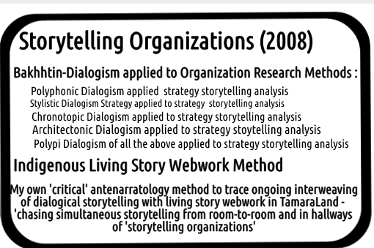
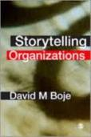

Slide 5
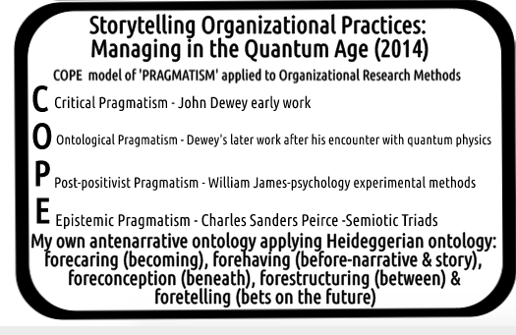
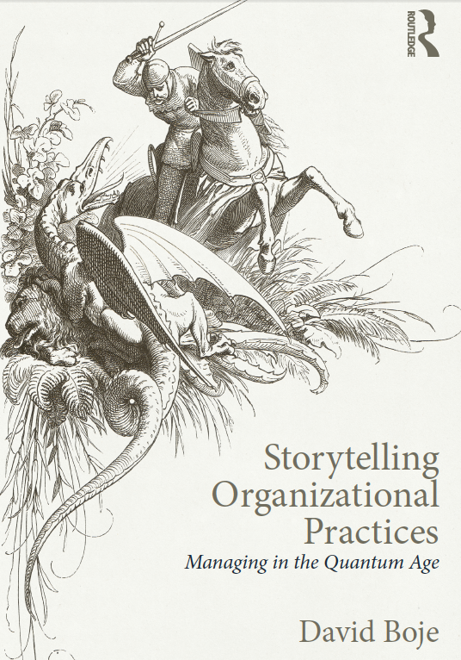

Slide 6
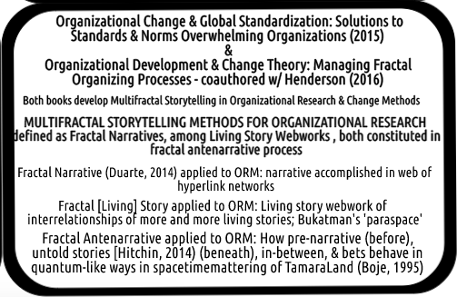

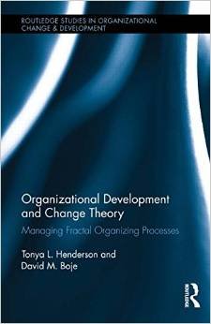

Slide 7
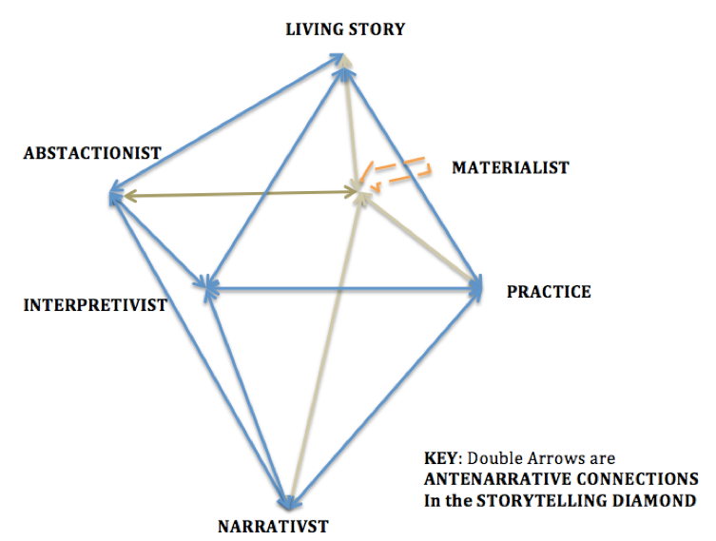
What is your Storytelling paradigm?
Rosile, G. A., Boje, D. M., Carlon, D. M., Downs, A., & Saylors, R. (2013). Storytelling diamond: An antenarrative integration of the six facets of storytelling in organization research design. Organizational Research Methods, 16(4), 557-580.

Slide 8
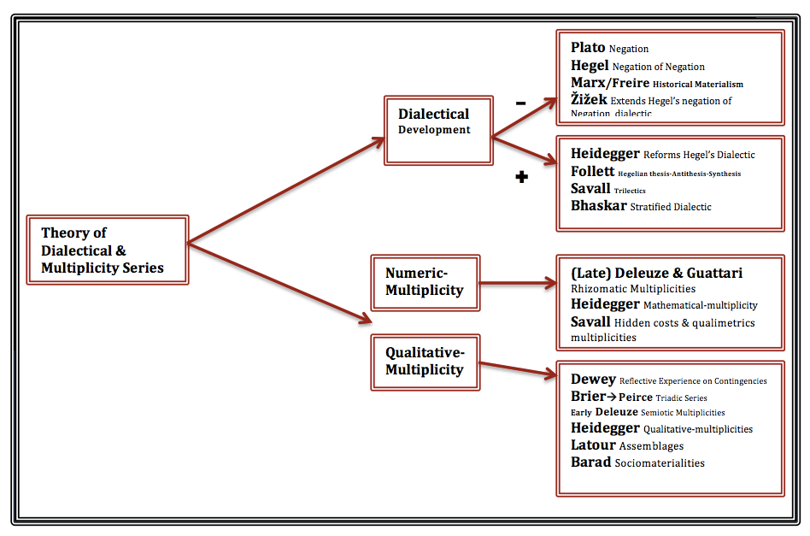
New book develops 10 approaches to get to 4th Wave Grounded Theory

Slide 9
Numeric-multiplicity algorithms held secret by over 100 software companies competing for market share is a swarm colonizing storytelling’s qualitative-multiplicity craft-traditions

Slide 10
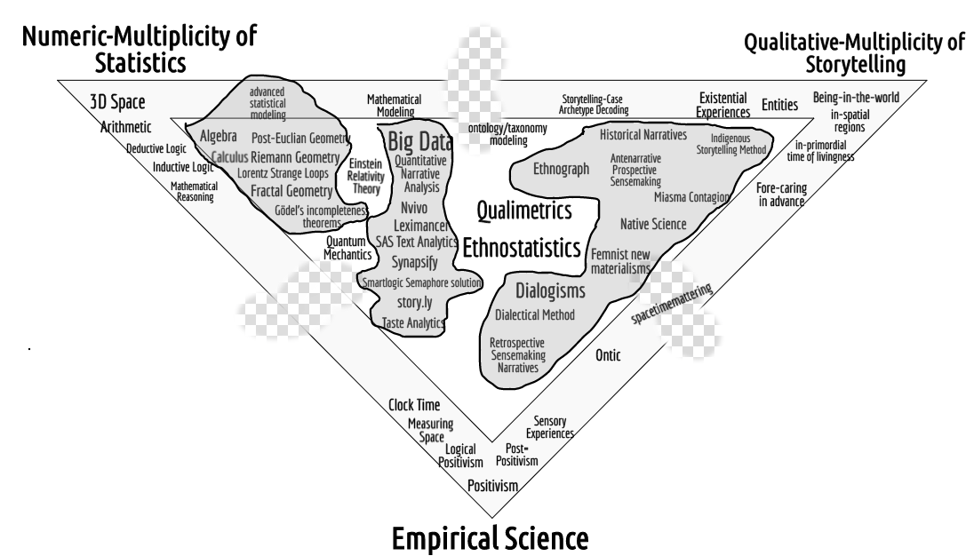
3 Paradigms of Inquiry in Broken Triadic

Slide 11
What QDA cannot do:
research the ‘untold stories’ in organizations (Hitchin, 2014; Izak, Hitchin, & Anderson, 2014).
trace the hidden stories, room to room, in TamaraLand (Boje, 1995). QDA cannot do indigenous storytelling research (Smith, 1999/2008).
do the detailed craft of critical storytelling analysis (Prasad, 2005). QDA cannot do living story research because living stories live, are situated in place, have time in communities, and have a mind all their own (TwoTrees, 1997, 2000).
Notes:
Living Story, for example is unfolding present, in a web of answerable spheres of relationship: family, work, community, friendship, education, institutional, etc. without beginning or end, just in the middle (Boje, 2008).

Slide 12
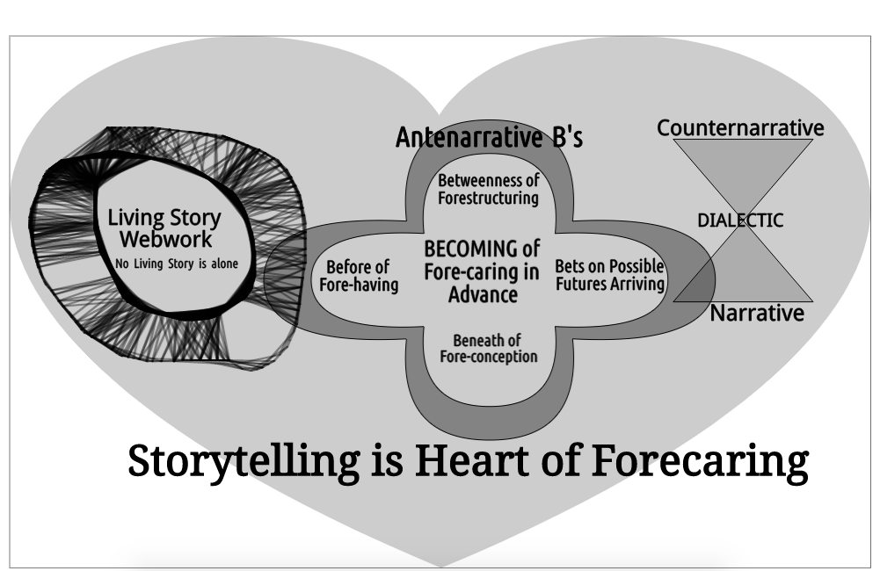

Slide 13


Example of qualitative Interpretative METHOD
THE STORYTELLING ORGANIZATION: A STUDY OF STORY PERFORMANCE IN AN OFFICE-SUPPLY FIRM by Boje, David .M., Administrative Science Quarterly, Mar91, Vol. 36, Issue 1 pp. 106-126.
With Excerpts from this research in the 2001 and 2008 books

Slide 14
“Organizations As Storytelling Systems In organizations, storytelling is the preferred sense-making currency of human relationships among internal and external stakeholders”
My most cited article, but this is all they mostly cite:

Slide 15
The rest of 1st paragraph
People engage in a dynamic process of incremental refinement of their stories of new events as well as on-going reinterpretations of culturally sacred story lines. When a decision is at hand, the old stories are recounted and compared to unfolding story lines to keep the organization from repeating historically bad choices and to invite the repetition of past successes. In a turbulent environment, the organization halls and offices pulsate with a story life of the here and now that is richer and more vibrant than the firm's environments

Slide 16
METHOD is called ‘in situ’
I am a participant observer I iteratively collected and analyzed (Spradley, 1980) the various social scenes that made up the discourse environment of an office-supply firm. These scenes included executive meetings held on and off-site: in conference rooms, restaurants, sales training sessions, as well as conversations in hallways and automobiles.
Tapes were transcribed and converted to line-numbered transcripts. Transcripts were analyzed to find the scantiest occurrences of story performance embedded in conversation. A story performance was operationally defined as an exchange between two or more persons during which a past or anticipated experience was being referenced, recounted, interpreted, or challenged.

Slide 17
TRANSCRIPTION
// Overlapping talk from the first to the last slash. Utterances begin with an upper-case letter and end with a period. .
.. A pause of one second or less within an utterance.
(2.0) A pause of more than one second within an utterance or between turns, the number indicates the length of the pause.
[* * *] A deletion.
[] An explanatory insertion.
Italics A word or part of a word emphasized by a speaker.
? A question, marked by a rise in pitch. ! An exclamation, marked by a rise in pitch or intense body language.

Slide 18
Stories-As-Texts Research
The story was not found to be a highly agreed-upon text, told from beginning to end, as it has been studied in most prior story research. Rather, the stories were dynamic, varied by context, and were sometimes terse, requiring the hearer to fill in silently major chunks of story line, context, and implication. Stories were frequently challenged, reinterpreted, and revised by the hearers as they unfolded in conversation.
NEXT AN INTERACTIVE TEXT ANALYSIS

Slide 19
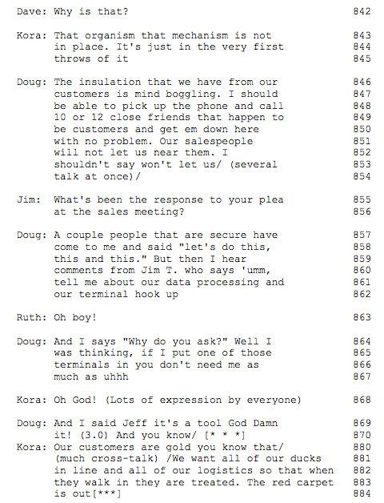
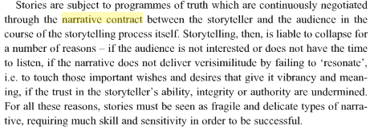
lines 846-54, story details are so terse that, at first glance, there may not appear to be a story at all.
Indeed in Gabriel (2000) this story does not fulfill the narrative contract
Czarniawska 92004) would say its not an emplotment, because it is not a Beginning, Middle, End telling and strong corporate cultures have petrified narrative plots
However, in lines 855-6, another executive hooks into the underlying experience to trigger more detail on the story behind the story. In 859-62, the story of a salesperson's reaction to executive attempts to implement computer information-system controls garners a severe group reaction.
In line 870, Doug uses a very common reflexive "you know" to reference experience that the other executives are expected to fill in between the lines. He references a story everyone knows all too well
In line 870, the use of an extended pause that invites hearers to fill in their knowledge of the story behind the performed story.

Slide 20
Stories-As-Performance (only)
In Yiannis Gabriel’s Story-as-Performance, ‘proper stories’ are emotive & fulfill implicit narrative contract.
My reply: First, because stories are contextually embedded, their meaning unfolds through the storytelling performance event across spaces/times (see Disney as Tamara-Land, AMJ 1995)
Second the 1991 research supports a theory of organization as a collective storytelling organization in which the performance of stories is a key part of members' sensemaking and a means to allow them to supplement individual memories with institutional memory, therefore ‘You now the story!’ though improper is part of sensemaking

Slide 21
Stories As Performance and Text
Because "the story" behind the story as performed is analogous to the text of it, text and performance can be viewed as two sides of the same coin.
For example, in everyday conversation, we make discursive reference to stories as texts in such phrases as "You know that part of his story, don't you?"; "That's my story too"; "You need to get the story straight"; "To make a long story short . . ."; or "l won't bore you with the whole story; You know it!"
People are engaged in a dynamic process of incremental refinement to the story lines of even very widely accepted story texts. Performances at times refer to taken-for-granted texts ("You know the story."), and story performance is a process in which people interact to incorporate new tales continuously into the corporate culture while rewriting oral history by revising the old stories that anchor the present to the past [and future]

Slide 22
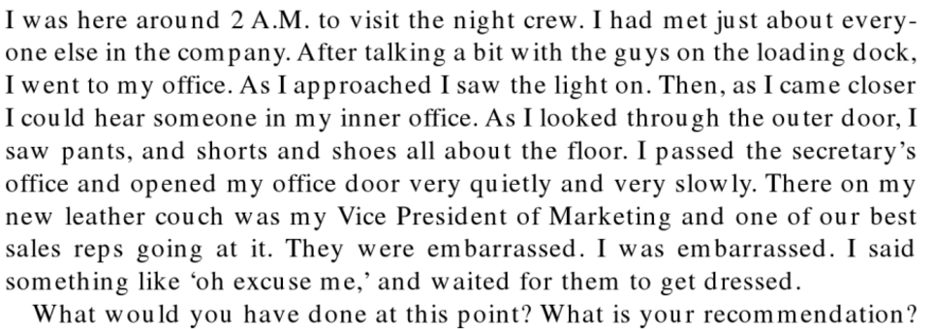
INTERACTIVE CASE, In pairs, Decide, What you will recommend if the CEO asks you the researcher & consultant (from Boje, 2001: 126)
CEO says:

Slide 23
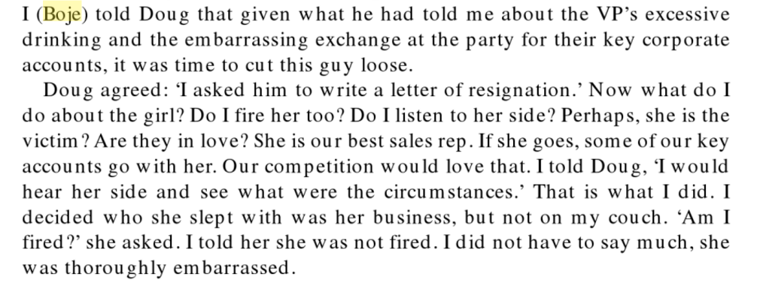
What I did (Boje, 2001: 126)

Slide 24
Tersely Told Story in 1991 article:
“Only the chief executive officer (CEO) and a few executives may be told that the sales manager was fired for drunken indiscretions with a saleswoman on the CEO's couch; vendors only hear that the manager did not get on with the CEO; customers learn that Fred resigned; middle management suspects an affair with Mildred. Each performance is never the completed story; it is an unraveling process of confirming new data and new interpretations as these become part of an unfolding story line.”

Slide 25
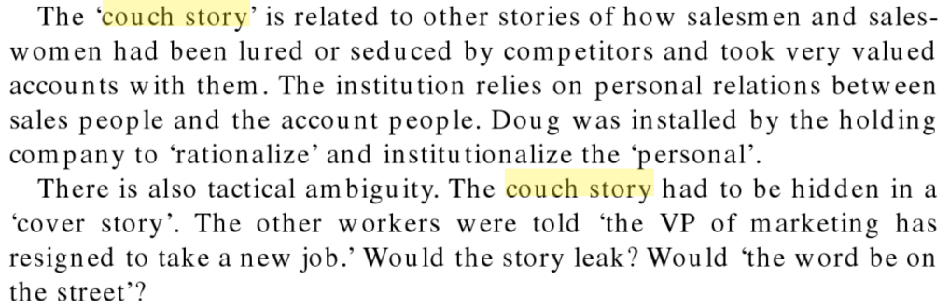
Wider embeddedness in web of stories of STORYTELLING ORGANIZATIONS (Boje 2001: 127)

Slide 26
Doug’s Storytelling Intervention
One story that was repeated in many office conversations concerns how, upon Doug's arrival as the new CEO, a non-gone executive tried to implement reserved parking privileges for executives. Doug, in almost his first meeting with the executives, uprooted a "reserved for the CEO" (one was also reserved for each of the VPs) parking sign and threw it on the executive meeting table, demanding to know
"who put up this sign?
This is not the kind of leadership I will have around here." The offending executive, for this and other good reasons, was fired by week's end.
This story made the rounds and reinforced Doug's image as the reformer who would not put up with special privileges for executives. This Doug-as-savior theme resurfaces in stories from vendors and customers. For Gold, this is a relatively new story, since Doug is the latest CEO. A year from now this might be tersely referred to as the parking-sign story (Boje, 1991; analysis in Boje, 2008: p. 51)

Slide 27
Michael Rowlinson© 2010 ephemera 10(2): 199-213 Organizational memory reviews
“It is good to have Boje on our side. He is realistic about power and the limitations of resistance in a way that shows he has experience of it, as when he warns against heroics (p. 210):
  “People, in corporate settings, often learn the hard way to only express the logic the boss most wants to hear! In a business dialog, we are rarely free to express the logic we think, feel, believe, or intuit. Nor do we engage (very often, or more than once) in emotive-ethical acts, and be that one person who speaks back to power, asking power to be answerable to what is happening to the Other…. but more often narrative control (by a boss or some dominant coalition) is so powerful, so threatening, so terrorizing, that people are mostly silent, saying and posing whatever power wants to hear and see. (citing Boje, 2008: p. 21)
Robinson continues: “Boje highlights the counter-memories that are subordinated to the managerialist collective memory:
  “Work abuse is written onto the body memory. Carpal tunnel syndrome from typing, calluses of the farm worker, back pains of the garment worker, burns on the arms of the fry clerk, nasty bruises on the legs of stewardesses pushing carts down the aisle, and so forth are remembered. (citing Boje, 2008: p. 93)

Slide 28

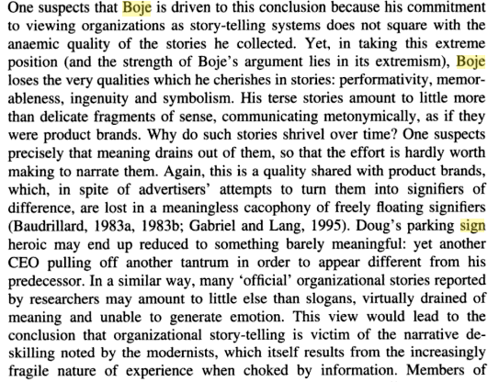
p. 96 Grant, D., Keenoy, T. W., & Oswick, C. (Eds.). (1998). Discourse and organization. Sage.

Slide 29
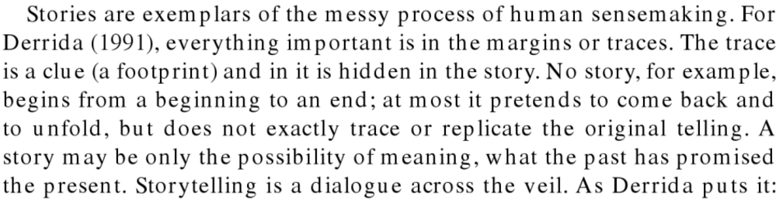
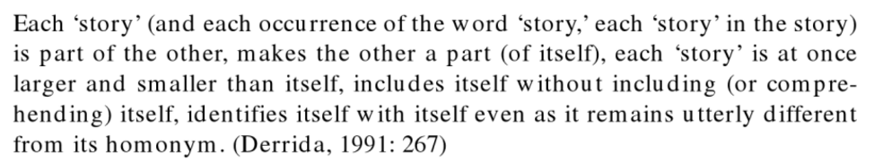
Boje 2001: 126

Slide 30
S1: Goldco Founding Story – part 1
Doug: I look at Goldco as a toy that 1154
somebody decided to put in the company 1155
because it was fun and it also brought 1156
in/ 1157
Sam: Well/ I'll tell you how that came 1158
about 1159
Doug: I thought you would (lots of laughter 1160
from the group) 1161
Sam: Sam Coche worked for Sea Breeze or 1162
something like that, oh you know the 1163
story? 1164
Doug: No go ahead tell it, really it's 1165
important. 1166

Slide 31
Continued
Sam: He got out there and he came over and 1167
they formed Goldco and Goldco does 1168
not mean Gold Company or anything 1169
else they took the first four 1170
initials from Billy Gold, which is 1171
G O L D and from Coche and that's how 1172
they got Goldco. 1173
Doug: And it was a good living for a couple 1174
of people. It was a nice toy for 1175
Billy, he made a few bucks on the 1176
thing. He had some fun for it but 1177
then the motivation at that time was a 1178
whole lot different than it is today. 1179
We don't have the luxury of screwing 1180
around with something like that /(lots 1181
of cross talk at this point)/ 1182
(Returns to turn-by-turn talk.)

Slide 32
RENO BRANCH STORY
Sam: I think five years ago there was no 727
Executive Committee. He just ran 728
the place the way he wanted as if you 729
wasn’t here. Raymond was [conglomerate’s] 730
man and he did what he pleased. 731
I guess you heard this all already 732
Dave: I heard about the high growth (nodding) 733
Sam: Yes we picked up San Diego 734
Dave: Reno? 735
Sam: Ed Fox picked up Reno and I guess 736
you heard the whole story before. 737
That’s why we picked up Reno because 738
Ed Fox had that with his father. You 739
know. 740

Slide 33
Mythic of Reno Branch Story
The Reno Branch stories and other stories made the rounds and reinforced Doug’s image as the reformer–savior who would not put up with special privileges for executives that had been perfectly OK in the old framework.

Slide 34
3 MAIN POINTS
A story can be more than backward-looking BME or fragmentation retrospection.
It can convey a forward-looking prediction of future organizational behavior
There are also these counter-narratives. The story was not found to be a highly agreed-upon text, told from beginning to end, as it has been studied in most prior story research. Rather, the stories were dynamic, varied by context, and were sometimes terse, requiring the hearer to fill in silently major chunks of story line, context, and implication. Stories were frequently challenged, reinterpreted, and revised by the hearers as they unfolded in conversation. (Boje, 1991: 106, boldness mine)

Slide 35
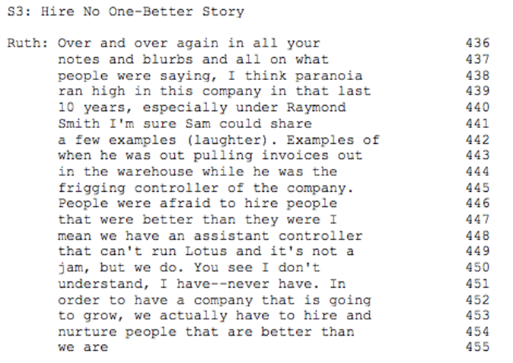
Background before your exercise

Slide 36
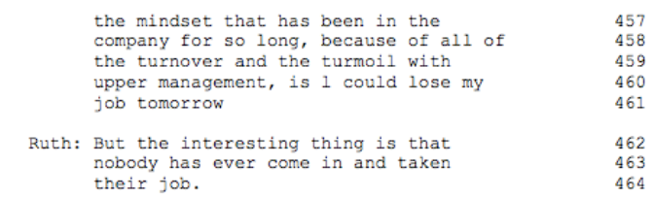
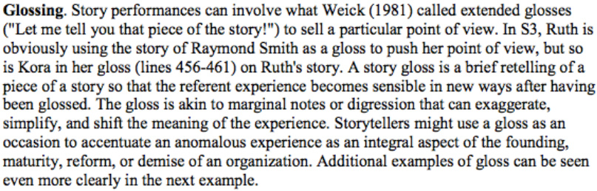
What is going on in this company?

Slide 37
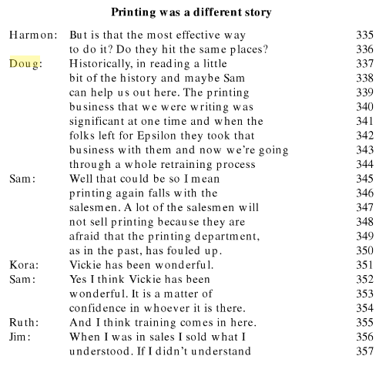
2001 p. 120

Slide 38
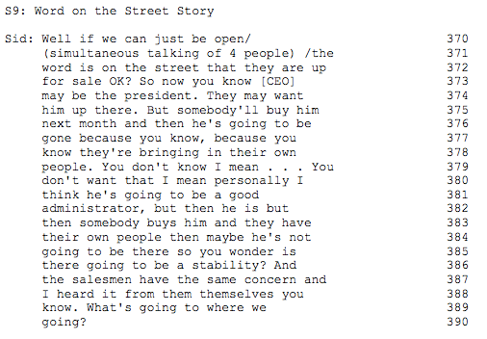
Background before next exercise

Slide 39
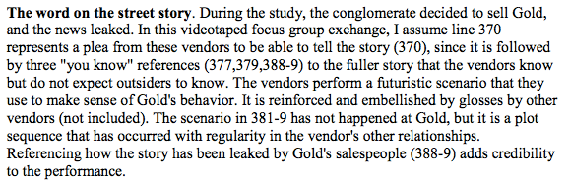
Interpretation

Slide 40
CEO Turnover Story by Vendors
Do this as Group Exercise
Dan: Yeah, my boss will call from 337
We’re based out of the Northwest and 338
he’ll say ‘Well Dan who is running the 339
ship at Gold now?’ He can see a 340
lot of the proposals that we’ve 341
presented and were accepted six months 342
ago still in effect because there’s 343
been turnover[***] 344
You know is the next administration 356
going to come in and make changes to 357
that? One point that Jeff made 358
earlier that I want to touch on is our 359-
concerns are shared with their 360
salespeople. They definitely know 361
sometimes that they’re kind of a ship 362
without a rudder right now and I think 363
it concerns their salespeople as well 364
From Film of Focus Group
-observed pattern of past events (337-44) to a prediction of a probable future pattern (356-64).
What is interesting is that the vendors leave most of the script unstated in their terse telling of the story.

Slide 41
POINT ‘Counter-Stories’ & Official Stories
Storytelling organizations, such as Gold, can be analyzed according to the distribution and frequency of various framework types that … dualize narrative & counternarrative relations

Slide 42
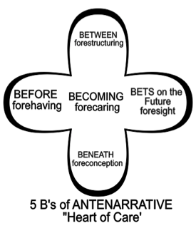
Heart-of-Care
Fore-caring in advance for Becoming

Slide 43
(2008) I went back to my texts to study Antenarratives --‘turnover in senior management’
(‘change in philosophy’ (lines 346–7),
agreements are worked out and new management changes the agreements (958–61).
These antenarratives are ‘bets’ and ‘pre-stories’ that some BME narrative will emerge, such as ‘we have to reinvent the wheel’ (961–2) every time a new CEO is installed at Gold because they are not honoring old deals. Frank is a customer, from a large corporation, a purchasing agent, who expresses emotive–ethical concerns. ‘I don’t care how they resolve their internal politics’ (350–1),
‘I need the product’ (352),
but with the turnover each ‘president has [their] own stamp of how he is going to operate and things change’ (347–9)
Barbara Czarniawska (2004), and her theory of petrified narrative would agree. This is why above I make storytelling the broader term, and look at the relation of the petrified narratives seeking stability (rarely changing) with the emotive stories (aka living stories) that change more readily and Antenarratives that change the Petrified Narrative order of a Storytelling organization

Slide 44
More Antenarratives
The video of Frank shows very emotive behavior, and the audio reveals an inflection of tonality that vibrates in ways that the words of the transcript below do not capture. The audiotape of intonations and pauses, and videotape of body language reveals a horse-sensemaking going on that is occurring beyond the words. Several I–we dialectics are evident in the transcript. The ‘I’ of the purchasing agent is opposed by the turnover in CEOs, as well as new vice presidents, and sales managers. The rapid turnover has resulted in systemicity problems of stability and access in Gold’s relations to customers. Doug, the CEO who hired a marketing professor and meas consultants, is the la est in a succession of five CEOs brought in in just two years.A Customer Story

Slide 45
More Antenarratives
Do this as Group Exercise
Frank: And I’m seeing symptoms of the 342
turnover in senior management they 343
have had senior management that they 344
have had in the past 14–15 months 345
where they have had a change in 346
philosophy. A certain president has 347
own stamp of how he is going to operate 348
and things change. My major concern is 349
the end result. l don’t care how they 350
resolve their internal politics 351
I need the product 352

Slide 46
More Antenarratives
Do this as Group Exercise
[***] They do listen but with half an 954
ear maybe because of the change in 955
management. 956
Certain management we have had 957
discussions and we have come to agreements 958
and the systems have been worked 959
out. New management comes in a new 960
president of the company and we have to 961
reinvent the wheel and we go back and I 962
mean it’s in writing it’s documented 963
these agreements are documented and then 964
go to the next person 965

Slide 47
Implications of STORYTELLING ORGANIZATION Research
Lot of attention will be given to negotiating the storyline interpretation and processing collectively the numerous sides to a story.
Completeness of the storytelling itself will vary from one sector and level of the organization to the next One story will take a more abbreviated form with those in-the-know, who are expected to know the particulars, but the same story will be told with a lot more detail to newcomers, outsiders, and most likely to researchers.
Story Ownership rights. Part of knowing how to behave in a storytelling organization is knowing who can tell and who can be told a particular story ("I don't know if the corner office would want that story to get around."). Certain people will have entitlement rights to a story
Being a player in the storytelling organization is being skilled enough to manage the person-to-person interaction to get the story line woven into the ongoing turn-by-turn dialogue using a broad class of behaviors called qualifiers, markers, and the like, that sustain storytelling across extended discourse by means of paralinguistic and kinesics' cues such as head nods, postural shifts, and eyebrow raises

Slide 48
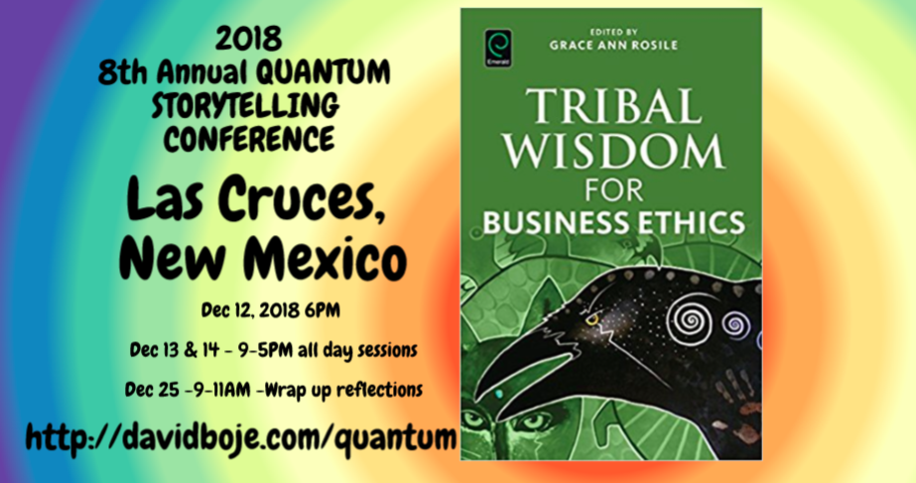
Q & A
Slides & books to download at http://davidboje.com/Strathclyde/

